Slide 1

Predicting customer buying behaviour
By : Aldiva Wibowo

Slide 2
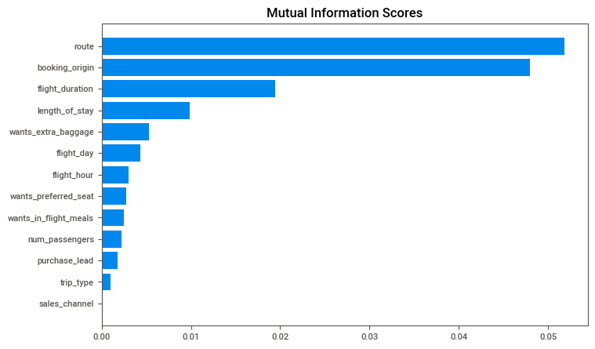
predictive model to understand factors that influence buying behaviour
Trained dataset using Random forest classifier model.
Achieved an accuracy of 85.09%.
Obtained an AUC score of 0.558.
Top 5 features that significantly influence customer buying behavior are:
Booking origin
Flight duration
Wants for extra baggage
Length of stay
Route
Need to improve AUC score.

